Slide 1

AIDS
Presented by: Zakharov Denis, J4232c & Grigorev Mikhail , J4233c

Slide 2

AIDS
In the U.S., most people with HIV (virus that attacks cells that help the body fight infection, making a person more vulnerable to other infections and diseases) do not develop AIDS because taking HIV medicine as prescribed stops the progression of the disease.
Global HIV statistics
39.0 million [33.1 million–45.7 million] people globally were living with HIV in 2022.
1.3 million [1 million–1.7 million] people became newly infected with HIV in 2022.
630 000 [480 000–880 000] people died from AIDS-related illnesses in 2022.
2

Slide 3
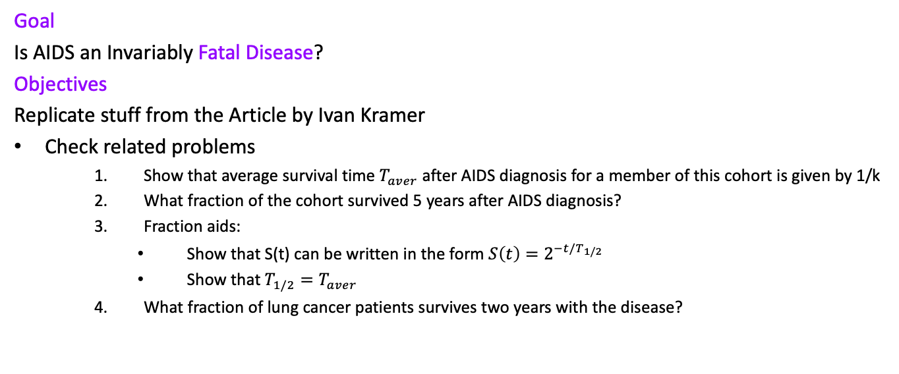
Purpose and objectives of study
Goal
Is AIDS an Invariably Fatal Disease?
Objectives
Replicate stuff from the Article by Ivan Kramer
Check related problems
Show that average survival time $T_{aver}$ after AIDS diagnosis for a member of this cohort is given by 1/k
What fraction of the cohort survived 5 years after AIDS diagnosis?
Fraction aids:
Show that S(t) can be written in the form $S\left(t\right)=2^{−t/T_{1/2}}$
Show that $T_{1/2}{=T}_{aver}$
What fraction of lung cancer patients survives two years with the disease?
3

Slide 4

Problem
Is AIDS an Invariably
Fatal Disease?
Barack Hussein Obama II 44th President of the United States
4

Slide 5
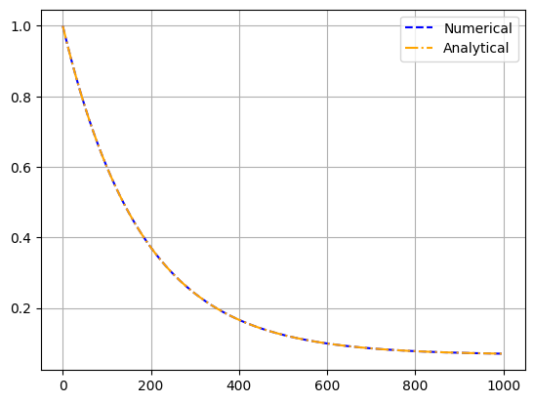
Replication of article results
5

Slide 6
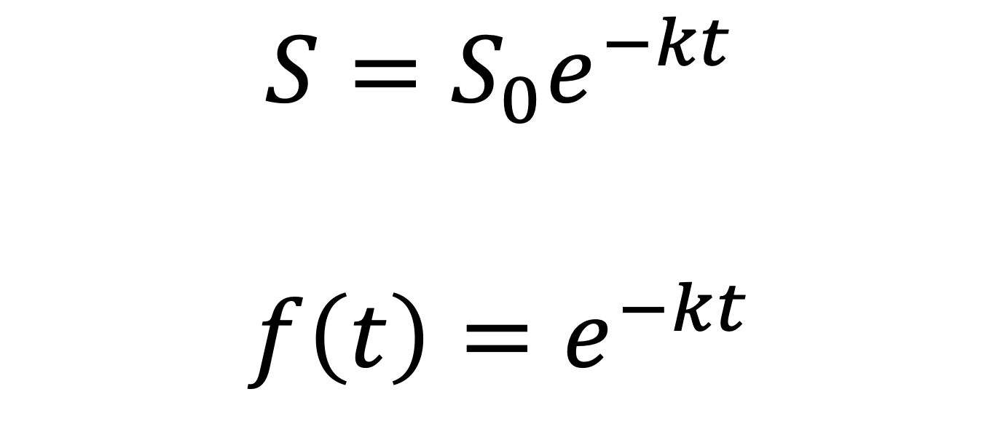
Related problem 1
$$S=S_{0}e^{−kt}$$
$$f\left(t\right)=e^{−kt}$$
6

Slide 7
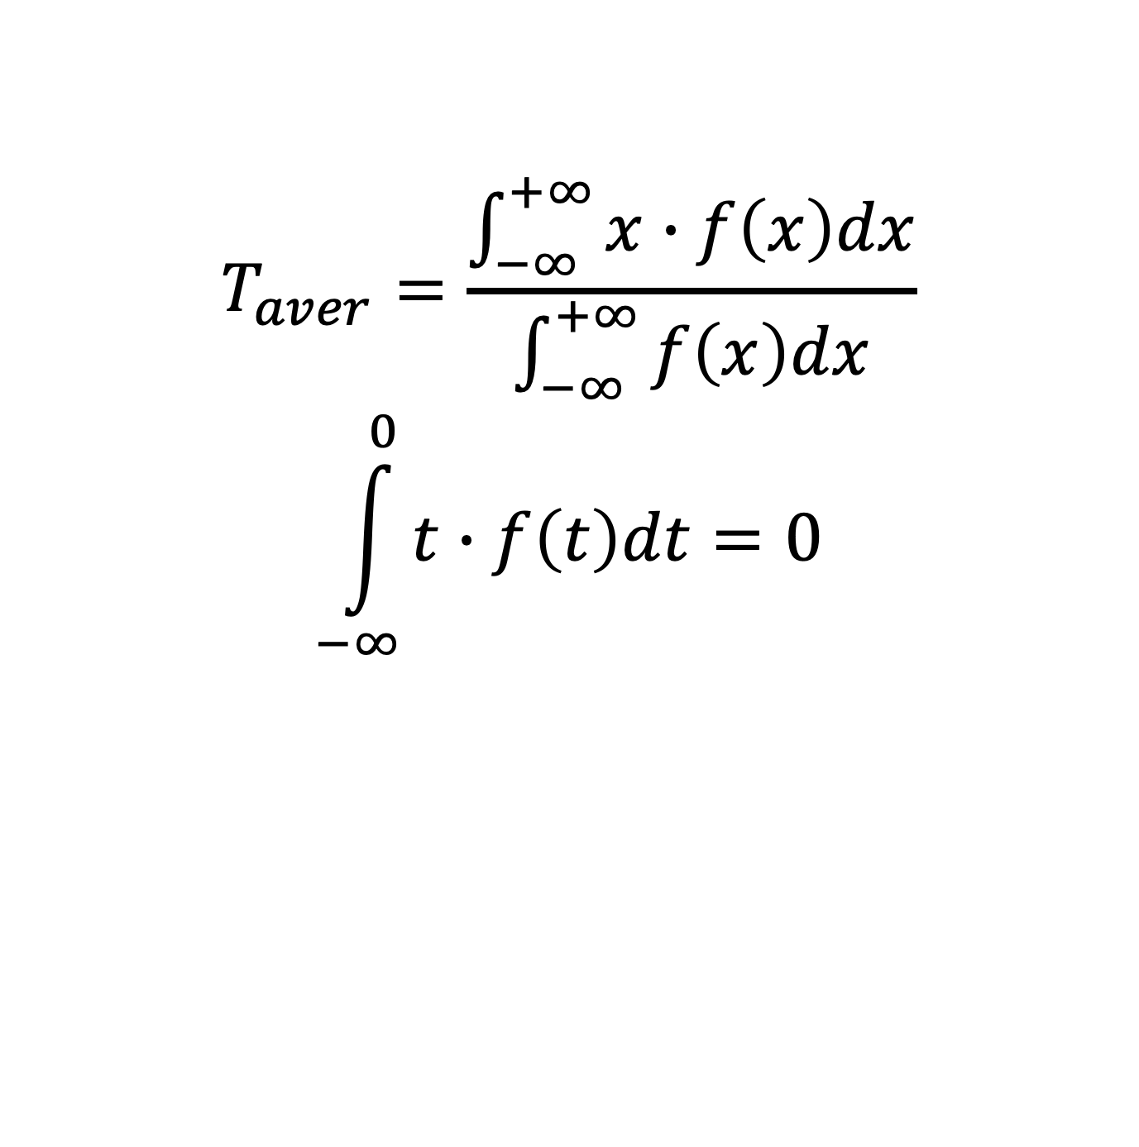
Related problem 1
$$T_{aver}=\frac{\int_{−∞}^{+∞}{x∙f\left(x\right)dx}}{\int_{−∞}^{+∞}{f\left(x\right)dx}}$$
$$\int_{−∞}^{0}{t∙f\left(t\right)dt=0}$$
7

Slide 8
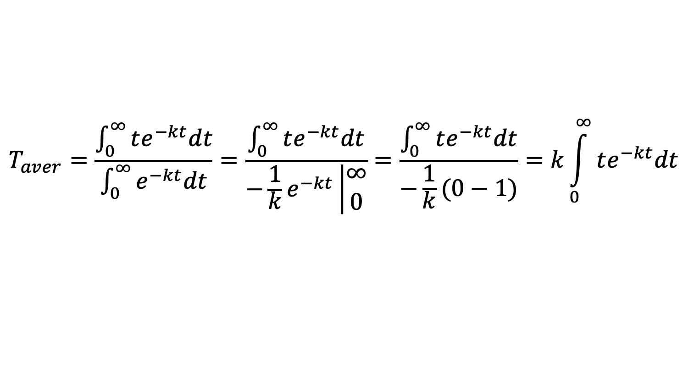
Related problem 1
$$T_{aver}=\frac{\int_{0}^{∞}{te^{−kt}dt}}{\int_{0}^{∞}{e^{−kt}dt}}=\frac{\int_{0}^{∞}{te^{−kt}dt}}{−\frac{1}{k}e^{−kt}\left|\begin{matrix}∞ \\ 0\end{matrix}\right.}=\frac{\int_{0}^{∞}{te^{−kt}dt}}{−\frac{1}{k}(0−1)}=k\int_{0}^{∞}{te^{−kt}dt}$$
8

Slide 9
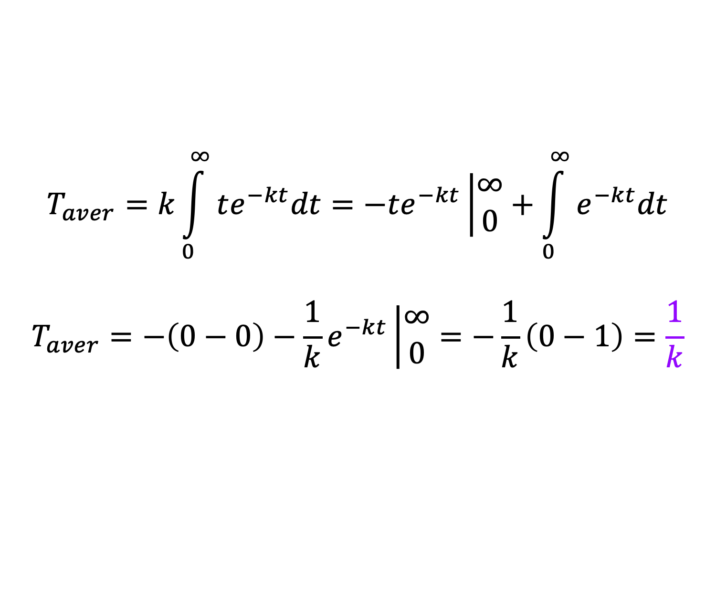
Related problem 1
$$T_{aver}=k\int_{0}^{∞}{te^{−kt}dt}=−te^{−kt}\left|\begin{matrix}∞ \\ 0\end{matrix}\right.+\int_{0}^{∞}{e^{−kt}dt}$$
$$T_{aver}=−\left(0−0\right)−\frac{1}{k}e^{−kt}\left|\begin{matrix}∞ \\ 0\end{matrix}\right.=−\frac{1}{k}\left(0−1\right)=\frac{1}{k}$$
9

Slide 10
Related problem 2
$$S\left(t=60\right)=e^{−0.15625∗60}=e^{−9.375}≈8.48∗{10}^{−5}$$
10

Slide 11
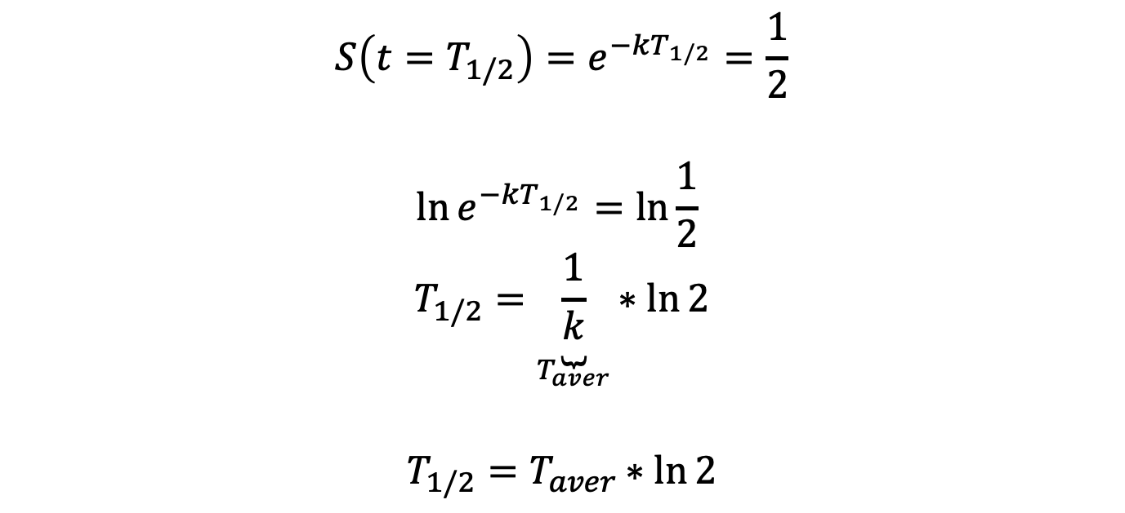
Related problem 3
$$S\left(t=T_{1/2}\right)=e^{−kT_{1/2}}=\frac{1}{2}$$
$$\ln{e^{−kT_{1/2}}=\ln{\frac{1}{2}} }$$
$$T_{1/2}=\underset{T_{aver}}{\underbrace{\frac{1}{k}}}∗ln{2}$$
$$T_{1/2}=T_{aver}∗ln{2}$$
11

Slide 12
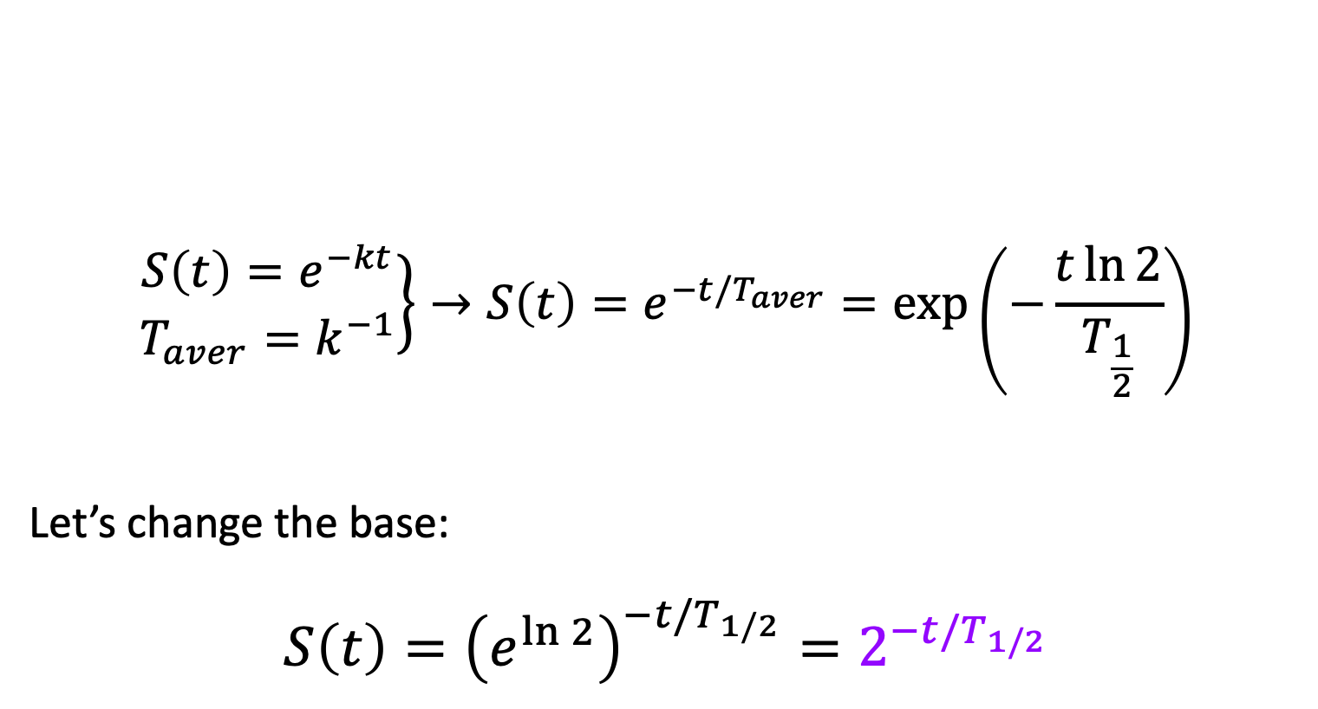
Related problem 3
$$\left.\begin{matrix}S\left(t\right)=e^{−kt} \\ T_{aver}=k^{−1}\end{matrix}\right\}→S\left(t\right)=e^{−t/T_{aver}}=\exp\left(−\frac{t\ln{2}}{T_{\frac{1}{2}}}\right)$$
Let’s change the base:
$$S\left(t\right)={\left(e^{\ln{2}}\right)}^{−t/T_{1/2}}=2^{−t/T_{1/2}}$$
12

Slide 13
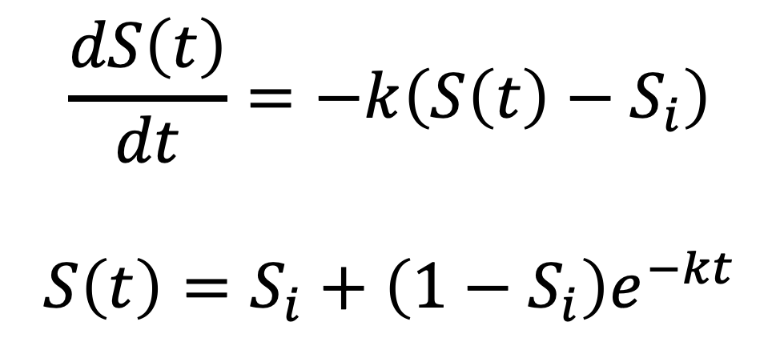
Related problem 4
$$\frac{dS\left(t\right)}{dt}=−k\left(S\left(t\right)−S_{i}\right)$$
$$S\left(t\right)=S_{i}+\left(1−S_{i}\right)e^{−kt}$$
13

Slide 14
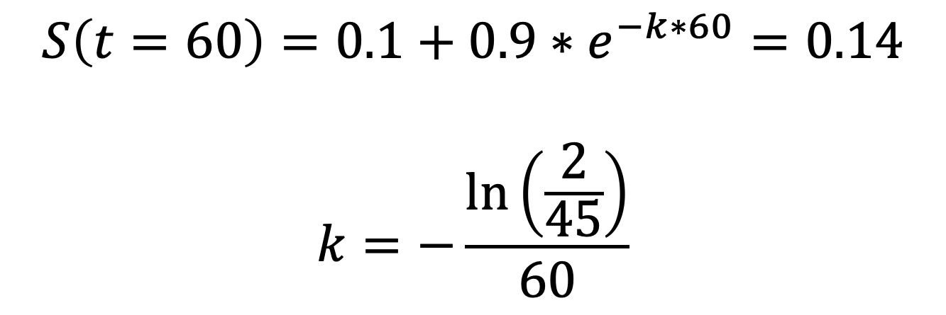
Related problem 4
$$S\left(t=60\right)=0.1+0.9∗e^{−k∗60}=0.14$$
$$k=−\frac{\ln\left(\frac{2}{45}\right)}{60}$$
14

Slide 15
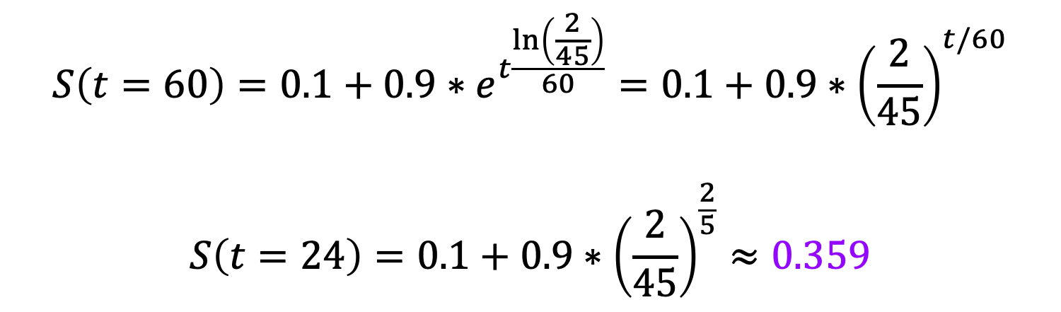
Related problem 4
$$S\left(t=60\right)=0.1+0.9∗e^{t\frac{\ln\left(\frac{2}{45}\right)}{60}}=0.1+0.9∗{\left(\frac{2}{45}\right)}^{t/60}$$
$$S\left(t=24\right)=0.1+0.9∗{\left(\frac{2}{45}\right)}^{\frac{2}{5}}≈0.359$$
15

Slide 16

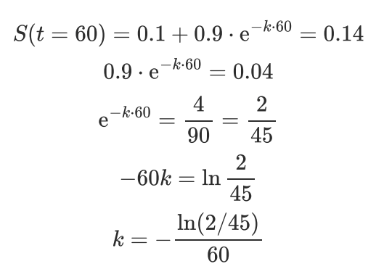
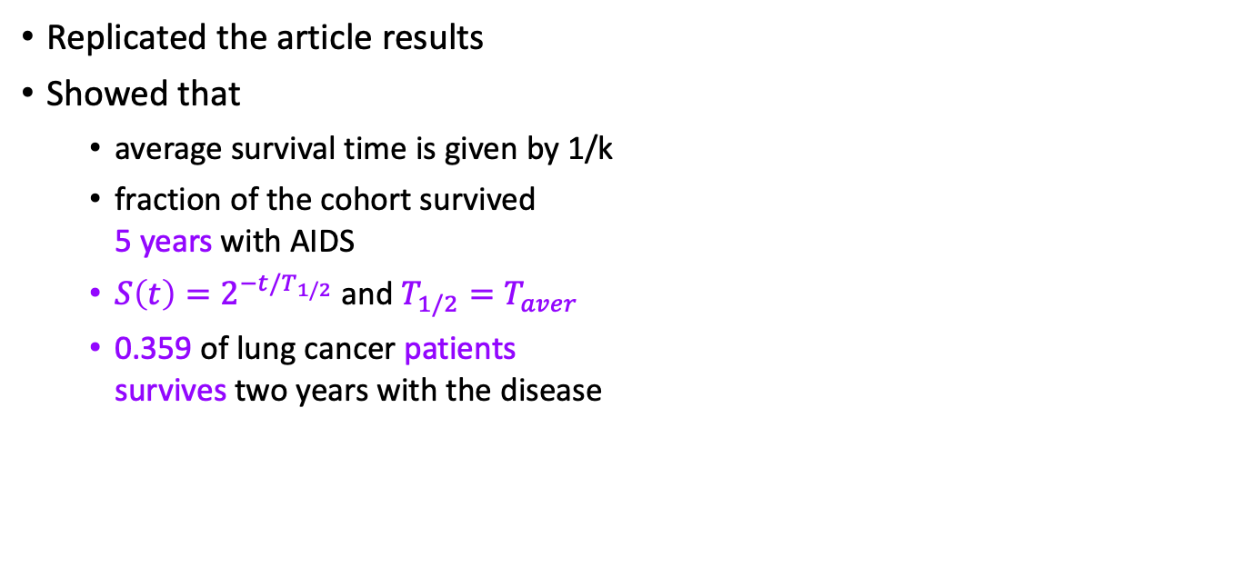
Research Summary
Replicated the article results
Showed that
average survival time is given by 1/k
fraction of the cohort survived 5 years with AIDS
$S\left(t\right)=2^{−t/T_{1/2}}$ and $T_{1/2}{=T}_{aver}$
0.359 of lung cancer patients survives two years with the disease
16

Slide 17

Resume
AIDS is Invariably Fatal Disease
Tensor factorization and hierarchical tensor factorization [25]
17

Slide 18
References
[1] I. Kramer, Ivan. What triggers transient AIDS in the acute phase of HIV infection and chronic AIDS at the end of the incubation period? Computational and Mathematical Methods in Medicine, Vol. 8, No. 2, June 2007: 125-151.
[2] Kramer, Ivan. Is AIDS an invariable fatal disease?: A model analysis of AIDS survival curves. Mathematical and Computer Modelling 15, no. 9, 1991: 1-19.
[3] Easterbrook, Philippa J., Emani Javad, Moyle, Graham, Gazzard, Brian G. Progressive CD4 cell depletion and death in zidovudine-treated patients. JAIDS, Aug. 6, 1993, No. 8: 927-929.
[4] Kramer, Ivan. The impact of zidovudine (AZT) therapy on the survivability of those with progressive HIV infection. Mathematical and Computer Modelling, Vol. 23, No. 3, Feb. 1996: 1-14.
[5] Stehr-Green, J. K., Holman, R. C., Mahoney, M. A. Survival analysis of hemophilia-associated AIDS cases in the US. Am J Public Health, Jul. 1989, 79 (7): 832-835.
[6] Gail, Mitchel H., Tan, Wai-Yuan, Pee, David, Goedert, James J. Survival after AIDS diagnosis in a cohort of hemophilia patients. JAIDS, Aug. 15, 1997, Vol. 15, No. 5: 363-369.
11

Slide 19

THANK YOU FOR YOUR TIME!
@misterzurg @dormant512

